Slide 1
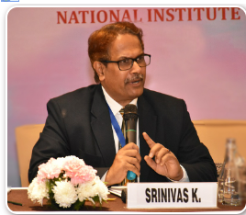
Competencies of Teachers in Designing, Developing & Delivering Blended Courses : A step by Step approach
Prof K Srinivas
Head ICT & Project Management Unit
Chairperson Digital Learning Cell
NIEPA
[Ministry of Education, GOI]
ksrinivas[AT]niepa[DOT]ac[DOT]in
9X5X8X0X0X
profksrinivas.in

Slide 2
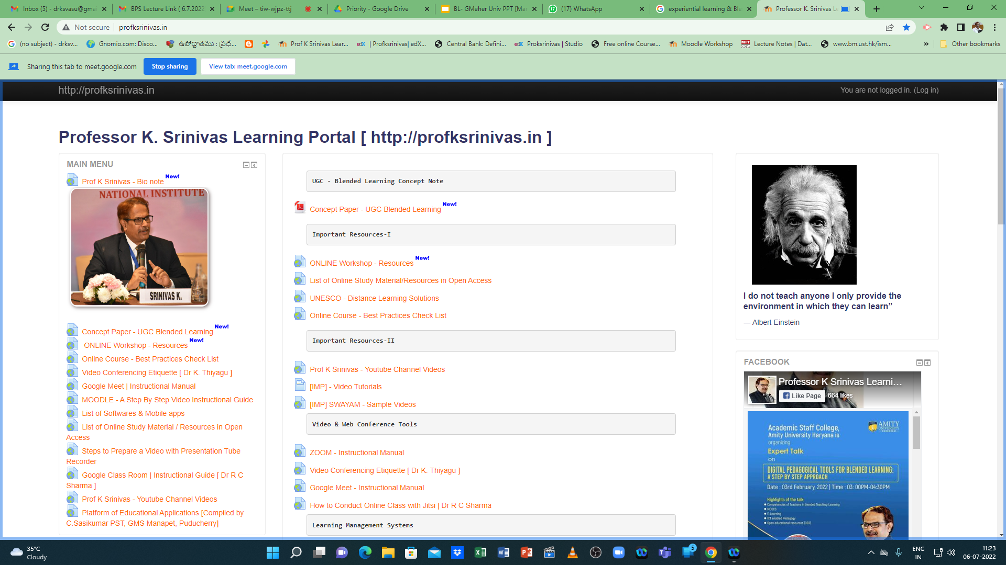
Professor K Srinivas Learning Portal : profksrinivas.in

Slide 3
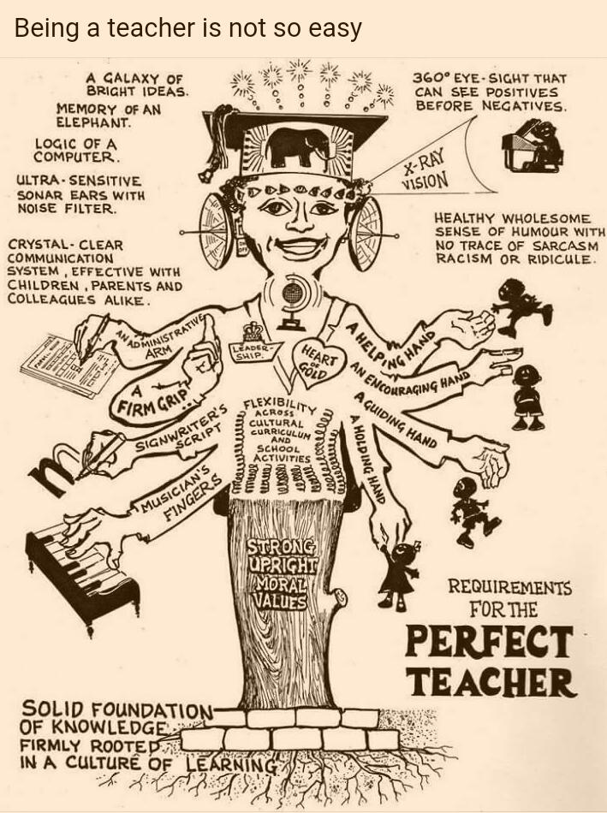
Being a Teacher is not so easy

Slide 4
NEP 2020
To make the process of learning
Impactful
Engaging,
Interesting and
Challenging for the learner.

Slide 5
Education (especially at the post-schooling level) should be skill-based , not only knowledge-oriented.
“Tell me, I will forget …
Show me, I may remember…
Involve me, I will understand”

Slide 6
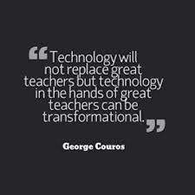

Slide 7
Technology : Always Keep in Mind …..
Technology is not a miraculous cure for all educational ailments
The Effectiveness of Technology is directly proportional to Competence , Environment,Intent & Attitude of user
Technology is like antibiotics, right dose is helpful, wrong does harmful
Technology is not only tools, it includes techniques too
Technology is a means, not an end

Slide 8
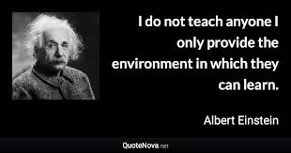
Source : Quotenova.net

Slide 9
Positive Attitude – The Key
“If you fail, never give up because F.A.I.L. means “First Attempt In Learning"
End is not the end, in fact E.N.D. means "Effort Never Dies"
If you get No as an answer, remember N.O. means "Next Opportunity". So Let's be positive.

Slide 10
21st Century Class
21st century class
Information is no longer at a premium – WWW! Lots of accessible videos, demos, etc
Hence, not enough for a teacher to only transmit information. Also - impossible to compete with WWW.
It is necessary for a teacher to ensure that students are able to assimilate the information, through appropriate and timely practice.
Teachers role from knowledge provider to coach and mentor. In addition S/he can be ‘Facilitator’ , ‘Guide’ , ‘enabler’ , co-learner.
Teachers can have an even more profound influence and effect on students learning. It now becomes more learner-centric and customized.

Slide 11
Teacher Role - Blended Learning
In Blended Mode of Teaching and Learning, the role of a teacher changes, from being just an education provider to a trainer and a guardian.
Role of teacher in Blended Learning environment is not limited to the “Sage on the Stage” but S/he becomes “ Creator, designer and supporter of teaching-learning environment to enable learners to interact.
Teacher’s role is more creative and challenging so as to design new experiences combining in-class and out-of-class activities using several resources, T-L strategies and digital and non-digital learning materials.

Slide 12
Role of a Learner in the BL Environment
[1] Responsible Learner
BL environment demand proactive learning on the part of the learner. S/he learns to take the responsibility of self and peer-learning out-of class as well as while in the class.
Frequent interactions with peers and teacher develop the sense of responsibility. Students become self-driven and responsible, tracking their individual achievements, which helps develop the ability to find the resources or get the help they need, self-advocating so they can reach their goals.

Slide 13
Role of a Learner in the BL Environment
[2] Problem-Solver
The problem-solving experiences of BL environment changes role of a learner from a ‘passive listener’ to a problem-solver.
Learner needs to understand the changed role and accept the challenges of new learning problems designed by the teacher.

Slide 14
Role of a Learner in the BL Environment
[3] Decision-maker
BL environment, with its Pool of Resources, Effective Learning Problems, and Appropriate Scaffolding of The Teacher, demands learner’s role as an efficient decision-maker.
While exploring, solving every small step of the problem, learner gradually develop ability of taking appropriate decisions. This changed role of the learners helps them to be ready for the external real-world.

Slide 15
The Six Essentials to be Acquired by teacher
Common for
Blended Learning Courses
MOOC Courses
Open & Distance Learning Programmes & Online Programmes
Strategies for
Course Planning & Designing
Selecting Appropriate Pedagogy
Content Development [ Create & Using existing ]
Selecting the Delivery Platforms [ Synchronous & Asynchronous ]
Course Transaction
Activities , Assessments & Interaction

Slide 16
Outcome : Transform Learning from Push to Pull
Centralised Learning
Learning Centric
Learner-Centric Learning

Slide 17
NEP 2020: Blended Learning
Given the emergence of digital technologies and the emerging importance of leveraging technology for teaching-learning at all levels from school to higher education, the NEP 2020 recommends for use of blended models of learning.
The NEP-2020 states that
“While promoting digital learning and education, the importance of face-to-face in-person learning is fully recognized. Accordingly, different effective models of blended learning will be identified for appropriate replication for different subjects. (NEP-24.4 (i), page – 62)”

Slide 18
Blend in Blended Learning
It is an instructional methodology, a teaching and learning approach that combines face-to-face classroom methods with computer mediated activities to deliver instruction.
This pedagogical approach means a mixture of face-to-face and online activities and the integration of synchronous and asynchronous learning tools, thus providing an optimal possibility for the arrangement of effective learning processes.

Slide 19
Blended Learning
BL is not a mere mix of online and face-to-face mode, but it refers to a well-planned combination of meaningful activities in both the modes.
The blend demands consideration of several factors, mainly focussing on learning outcomes and the learner-centred instructional environment.

Slide 20
The Objective of Blended Learning
The Primary Objective of Blended Learning is to make the process of learning not only impactful but also engaging, interesting and challenging for the learner.

Slide 21
Seven Steps to Blended Learning
There are Seven steps to successful implementation of Blended Learning :
Have a Plan
Take a baby step- One target at a time
Involve staff and students in the process
Set clear Learning Goals
Have right Teaching Resources
Make the system work for you
Monitor - Refine and Repeat

Slide 22
In-class learning [ Face-to-face (F2F) ]
The term ‘In-class learning’ refers to all activities within the classrooms/labs with Physical Presence of students and teacher including, but not limited to, experiences such as
Teacher’s Explanations
Demonstrations
Large Group Activities
Brainstorming
Discussions
Small Group Activities
Group-work
Problem-solving
Experiments

Slide 23
Face-to-face (F2F) Mode
Attending instructor’s short duration lectures for introducing or summarizing topics, understanding complex concepts resolving queries based on self-learning or group-learning
Participating in group activities in the classroom with peers, mainly for analyzing and applying information sought through eResources,
Collaborating and co-creating new knowledge borrowing and accessing books and periodicals from the library, field visits, sports, etc.
Face-to-face training, physical training, apprenticeships, internships, etc.
Physical labs, hackathons, working in maker spaces, etc.
Appearing for periodical assessments, summative tests on-campus, etc.
Any instructional activity for which students and teachers physically meet on the campus or else out of campus in the same geographical environments in the light of learning outcomes.

Slide 24
Out-of-class learning [ ICT Platforms / LMS ]
The term ‘Out-of-class learning’ refers to all activities outside the classrooms/labs with Non-Physical presence of students including, but not limited to, experiences such as
Accessing Resources with or without digital devices
Books, Newspapers, Journals, Pdf, Videos, Lecture Notes, Audio Files, Web-Pages, eBooks, eJournals, etc.)
Getting Involved in interactions with peers and community
Online Collaboration
Group-projects with classmates outside classroom
Visits to Workshops/Offices in surroundings

Slide 25
Online mode of learning
Accessing eResources, mainly in the form of Open Educational Resources (consisting formats such as text, graphics, animations, simulations, gaming, interactive multimedia, etc.) uploaded on LMS by the instructor
Accessing links, eResources, digital libraries suggested by the instructor as well as explored individually or in groups.
Studying MOOCs/ SMOCs, etc. by the learner as per guidelines by the instructor (e.g. Instructor may connect students to a successful ongoing MOOC but plan several on-campus activities alongwith it.)
Attending online virtual sessions of the instructor
Performing individual or group activities using any ICT tool or platform
Participating in the workshops/webinars as per suggested by the instructor related to the curriculum
Completing assignments and uploading on LMS / submitting to the instructor using other ICT platforms

Slide 26
Online mode of learning
Attempting tests/quizzes
Engaging into virtual labs, simulations etc.
Engaging in webinars, e-conferences, online short term training programmes, etc.
Engaging in online internships/ projects, etc.
Engaging in any activity directly related to the course curriculum for which learner is not needed to visit the classroom physically but needs to use digital devices and internet connectivity

Slide 27
Key Features of Blended Learning
· Increased student engagement in learning.
· Enhanced teacher and student interaction.
· Responsibility for learning.
· Time management and flexibility
· Improved student learning outcomes
· Enhanced institutional reputation.
· More flexible teaching and learning environment
· More amenable for self and continuous learning
· Better opportunities for experiential learning

Slide 28
Pedagogies for Blended Learning

Slide 29
Flipped Classroom

Slide 30
Definition: Flipped Classroom Pedagogy
Flipping the classroom (also known as “inverting” a classroom) is a “pedagogy-first” approach to teaching in which, course materials are introduced outside of the class [Online - Asynchronous Platforms ] , and in-class time [Face-to-Face] is re-purposed for inquiry, application, and assessment in order to better meet the needs of individual learners.

Slide 31
Steps
Flipped Classroom

Slide 32
Learner Centric MOOC Pedagogy Model

Slide 33
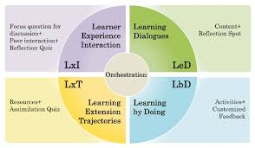
Learner Centric MOOC Pedagogy Model
LCM: A Model for Planning, Designing and Conducting Learner-Centric MOOCs.
The Learner-Centric MOOC (LCM) model consists of a set of design guidelines, activity constructors and recommended actions .
The LCM model guides instructors in conceptualizing, creating and conducting a MOOC, while maintaining a learner-centric pedagogical approach at its core.

Slide 34
Learner-Centric MOOC Model
Promotes concept acquisition through learner interaction
Learner Experience Interaction
Learning Dialogue (LeD)
Orchestration
Learning Extension
Trajectories
Learning
by Doing

Slide 36
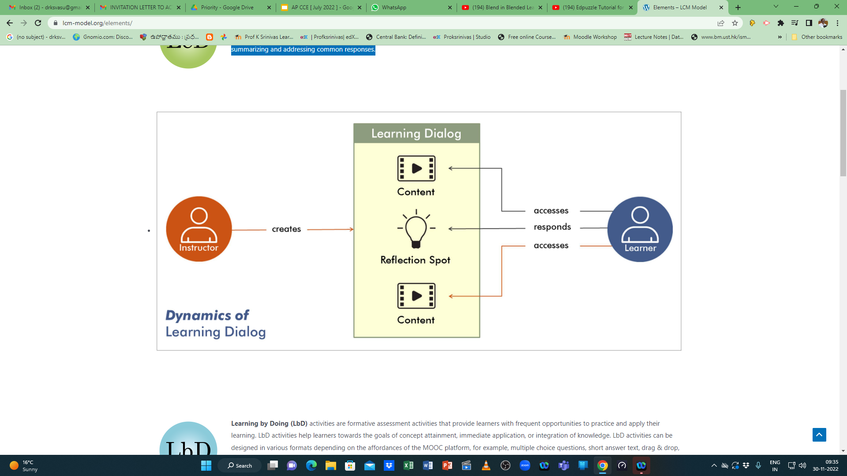
Learning Dialog (LeD) promotes concept acquisition through learner interaction. Each LeD consists of a short video providing conceptual knowledge, with explicit Reflection Spots for the learner to express prior conceptions or perform micro-practice.
At a Reflection Spot, the instructor poses a question or gives a brief activity and the video pauses. The learner is expected to respond to the question or activity.
The instructor wraps up the Reflection Spot by summarizing and addressing common responses.

Slide 37
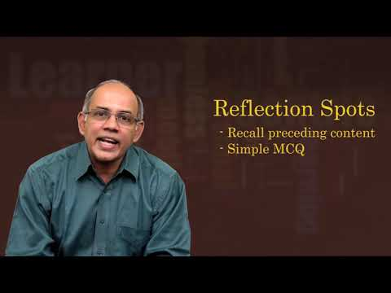
Introduction to Reflection Spot

Slide 38
Making Your Own LeD

Slide 39
Hands on Practice

Slide 40
Reflection Spot – Think and Write
Select a Short Subject Video Preferably [Picture -in-Picture] Video from Youtube.com /ePG Pathshaala
Notes:
https://bit.ly/2p3oPBm
,

Slide 41
Reflection Spot – Think and Write
Write down one advantage of putting a Reflection Spot
(from a learners’ point of view)
Notes:
https://bit.ly/2p3oPBm
,

Slide 42
Reflection Spot – Think and Write
Write down one advantage of putting a Reflection Spot from a learners’ point of view
Your Responses :
Whether learners’ have understood previous content
Breaks the monotony
Brings learner engagement with the content of the video
Notes:
https://bit.ly/2p3oPBm
,

Slide 43
Write down one advantage of putting a Reflection Spot from a learners’ point of view
Your Responses :
Whether learners’ have understood previous content
Breaks the monotony
Brings learner engagement with the content of the video
Notes:
https://bit.ly/2p3oPBm
,

Slide 44
LeD – Content Delivery Video
Learning Dialogue
Content delivery videos are long, LeDs are short
LeDs focused on a topic (content chunk)
Content
Reflection Spot
Content

Slide 45
LeD: Concept acquisition through learner interaction
Content
A short video that
Explains a single concept
Duration less than 10 minutes
Text readings
Animations
Learning Dialogue
Content
Reflection Spot
Content

Slide 46
LeD constructor
Template and Guidelines for creating your LeDs

Slide 47
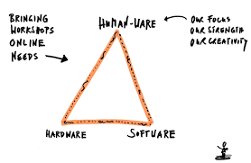
Core Components Blended Learning Implementation
[1] Hardware
Laptop/ Desktop/ Smartphone/ Webcam/ Microphone/ Writing Devices
[2] Software
Synchronous Learning Synchronous learning happens during real time Live face-to-face class. Here the students can interact, discuss, share and develop perspectives to all the content that they have studied and absorbed during the asynchronous mode.
[ Synchronous Learning ICT Tools: Skype/ZOOM/ Google Meet /Jitsi/Webex/GOTOmeeting/Microsoft Teams ]

Slide 48
Core Components Blended Learning Implementation
Asynchronous Learning
Objectives of Asynchronous Learning:
Asynchronous learning includes activities which students can pursue beyond their class hours/schedule.
This helps build content knowledge and allows students to apply learning in creative ways.
Recorded Lectures,econtent, Simulations are particularly well-suited for asynchronous learning as students can watch recorded sessions & read the econtent in their own free time, thus ensuring maximum and effective utilization of the time marked for live classes in face-to-face interactions and discussions.
ICT Tools Asynchronous Learning : MOODLE / Google ClassRoom/ Canvas /Edmodo/Blackboard

Slide 49
Advantages : Blended Instructional Method
Convenience of access to a wide variety of study material
Learner can learn on Own Pace, Space & Time
Students can engage with content in a variety of formats — video, text, audio — and can choose the format that suits them best.
Students can watch videos and read the content multiple times to help absorb content.
Wide variety and range of materials can be presented to increase learner choice.

Slide 50
Advantages : Blended Instructional Method
Opportunity for Collaborative learning
Students can collaborate with each other for enhanced and enriched peer learning like shared documents and message boards that act as supports in and out of class.
Inclusive learning through diversity of perspectives
Guest speakers from around the world can be invited much more
conveniently in online sessions to share their experiences.

Slide 51
[3] Humanware : The Competencies of Teacher for BL
Good Subject / Content Knowledge
Sound Pedagogical Understanding
Understanding the Blended Learning Environment & Its Ecosystem
Competencies for Designing, Developing and Delivering Blended Learning Course
Course Planning and Organization.
Verbal and Non Verbal Presentation Skills
Collaborative Teamwork.
Questioning Strategies.
Involving students and Coordinating their Activities.

Slide 52
Digital Pedagogical Tools for Blended Learning
Synchronous Learning Tools
Asynchronous Learning Tools
Summative Assessment Tools
Formative Assessment Tools
Collaborative Learning Tools
Content Development Tools
Sticky Notes Tools
Shared Document Tools
Concept Mapping ,& Mind Mapping Tools
Comprehensive Activity Tools
Interactive Presentation Tools

Slide 53
Synchronous Learning Tools
ZOOM
Jitsi
Google Meet
Cisco Webex
MS Teams

Slide 54
Asynchronous Learning Tools
[Supporting Out-of -Class Learning Activities]
Google Classroom
MOODLE
Canvas
Edmodo
Blackboard

Slide 55
Formative Assessment Tools
MeetingPulse
Vevex
Slido
Wooclap
Mentimeter
Polleverywhere
Flipgrid
Pigeonhole Live
Conference i/o
Ahaslides

Slide 56
Summative Assessment Tools
Quizizz
Hanoot
Nearpod
Quzalise
Socrative
Plickers
Testmoz
H5P
edpuzzle

Slide 57
Sticky Notes Tools
Jamboard
Ideaflip
Lino.it

Slide 58
Shared Document Tools
Google Docs
Google Sheets
Google Slides
Etherpad
Scatterspoke
Ideaboardz

Slide 59
Concept Mapping & Mind Mapping Tools
Miro
Google Drawing
Conceptboard
Coggle
Bubble.us
IMAP

Slide 60
Comprehensive Activity Tools
Padlet
Miro
Whimsical

Slide 61
Digital Content Development Tools
Slidator [PresentationTube Recorder]
OBS Studio
Screencast-o-matic [ Desktop / Laptop ]
Screencast-o-matic [ Mobile Version]
Freecam
Screencastify
Apowersoft
Greenshot

Slide 62
ICT Tools for Collaboration & User-generated content
Blogging | Blogger.com
Sticky Notes Tools | Jamboard, Ideaflip, Lino.it
Shared Documents Tools | Google Docs, Google Sheets, Google Slides, etherpad, scatterspoke, ideaboardz
Concept mapping, Mind mapping Tools | Miro, Google Drawing, Conceptboard, Coggle, Bubble.us
Comprehensive Activity Tools | Padlet , Miro , Whimsical

Slide 63
IMP Issues: Designing an BL Course
First Design the Curriculum, Objectives and expected outcomes and then consider how the BL Environment can best serve the instructional objectives and activities of that curriculum.
This requires changes in Pedagogy, with instructors taking the role of Facilitators of Information while guiding students toward solutions.

Slide 65
IMP Issues: Designing an BL Course
In order for Blended Teaching & Learning to be successful, Teachers as well as Learners must take on new roles in the teaching-learning relationship, and faculty must be willing to release control of learning to the students.

Slide 66
IMP Issues: Designing an BL Course
Course should be Instructor-led & Student-Centered
Course Format, Expectations and Instructions should be Clear and Concise.
Learning should be Collaborative in nature
Coursework should maximize Participation Flexibility and providing a framework for Student Pacing
Courses should faster Team-Building Skills and supports Critical Thinking
Activities and Assessments should account for different learning Styles

Slide 67
BL Course Ecosystem
Design
Development
Delivery
Transaction
Assessment
Engage

Slide 68
Managing Cloud Storage
Google Drive/OneDrive / Dropbox
Folder /Sub Folder Creation
Folder Permissions
Editor 2. Commenter 3. Viewer
File uploading
Collaborative Working
Content dissemination & Updation
Safety and Security of the Data
Device Independence

Slide 69
Working with Youtube
Content Producers
Content Consumers

Slide 70
Youtube → Video Content Dissemination
Privacy → Public, Private, Unlisted
Keywords → Sufficient Keywords needs to be prepared
License → Youtube Standard → Creative Commons Attribution [ reuse allowed]
Category → Education
Embedding → Yes / No
Comments → Yes / No

Slide 71
Hands on Exposure : ICT Tools for Collaboration & User-generated content
Blogging | Blogger.com
Stickynotes Tools | Jamboard, Ideaflip, Lino.it
Shared Documents Tools | Google Docs, Google Sheets, Google Slides, etherpad, scatterspoke, ideaboardz
Concept mapping, Mind mapping Tools | Miro, Google Drawing, Conceptboard, Coggle, Bubble.us
Comprehensive Activity Tools | Padlet , Miro , Whimsical

Slide 72
Ten Practices - Using Technology to Enhance
Teaching and Learning
Prepare an Institutional Policy of Technology for Teaching and Learning
Develop Institutional Website as a Learning Resource
Have an online accessible databank of students and teachers
Have an institutional learning management systems [LMS]
Develop an repository of learning resources

Slide 73
Ten Practices - using Technology to Enhance
Teaching and Learning
Prepare an online teaching and learning manual
Make online teaching and learning an integral part of curriculum
Develop modalities for e-assessments and start using it gradually
Develop modalities for Collaborative Learning environment.
Promote an online Teaching and Learning community to support and counsel each other
Publish best practices of technology-enabled teaching and learning regularly

